Slide 1
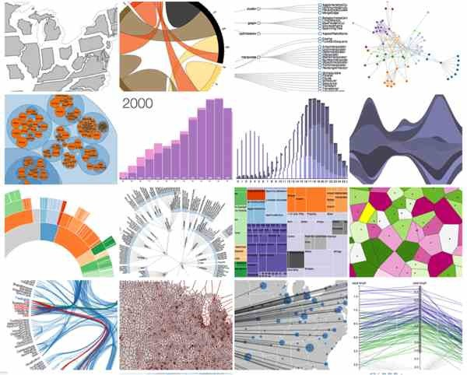
Visualizing data
Randy Leonard
Digital frameworks
Northwestern University – Spring 2020
Github.com/randyleonard99/digitalframeworks-spring2020

Slide 2
Steps to a data story
Find data
Clean data
Analyze data
Present data

Slide 3
What is a data visualization?
A story
More so: A visual story that conveys an understanding about some data.

Slide 4
Good data viz examples
Animated unemployment
Brussels street names
Covid symptoms

Slide 5


Slide 6
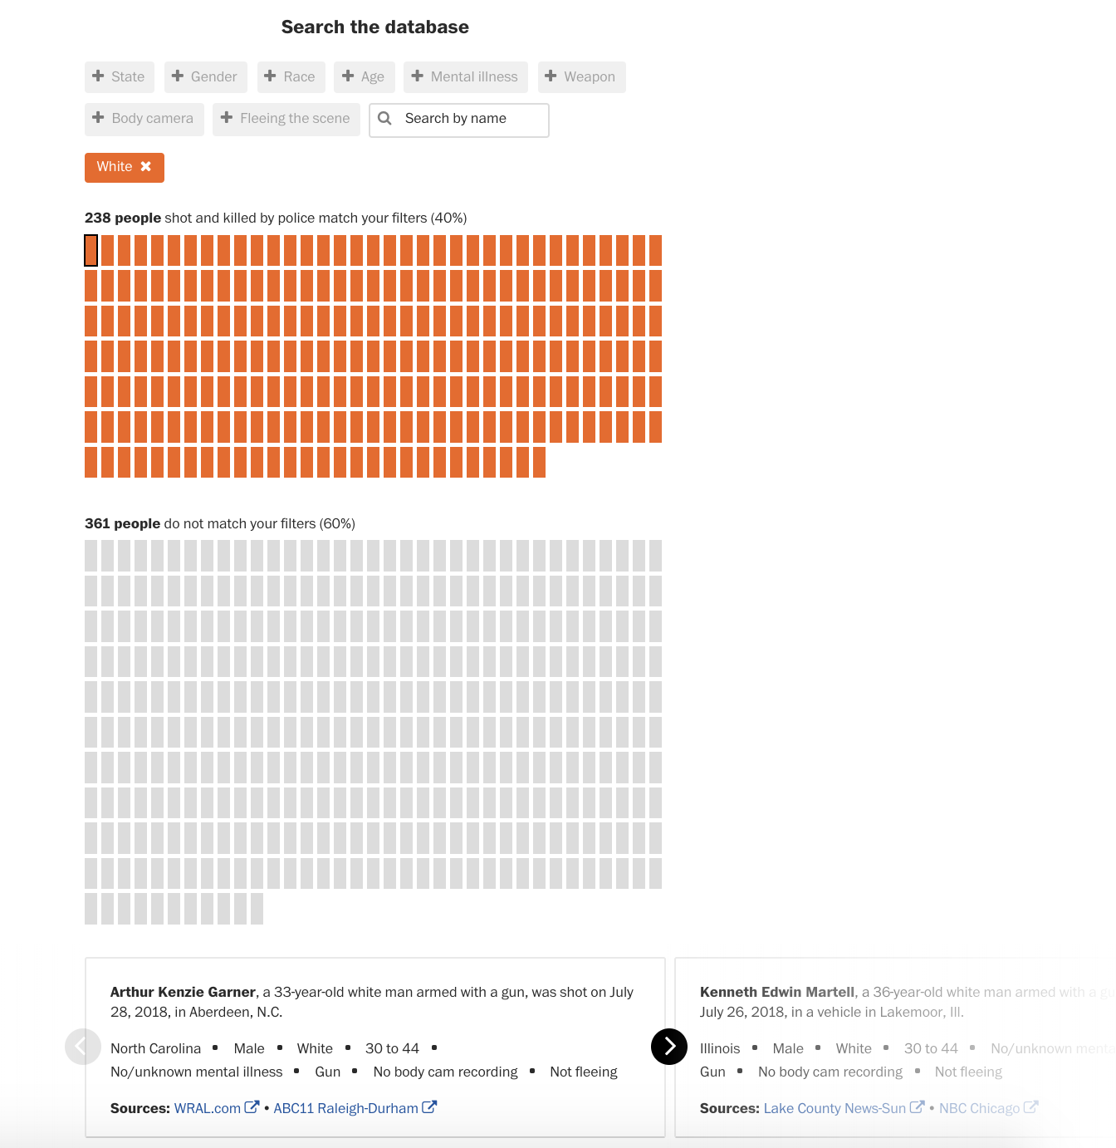
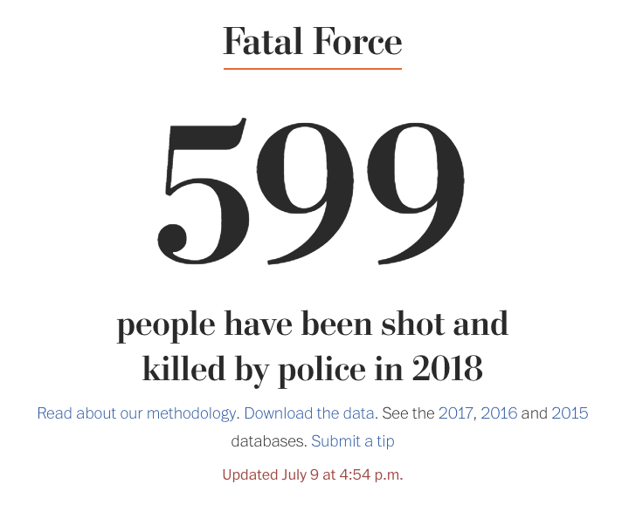
What Makes a Good Viz?
Tell a clear story
Find meaning

Slide 7
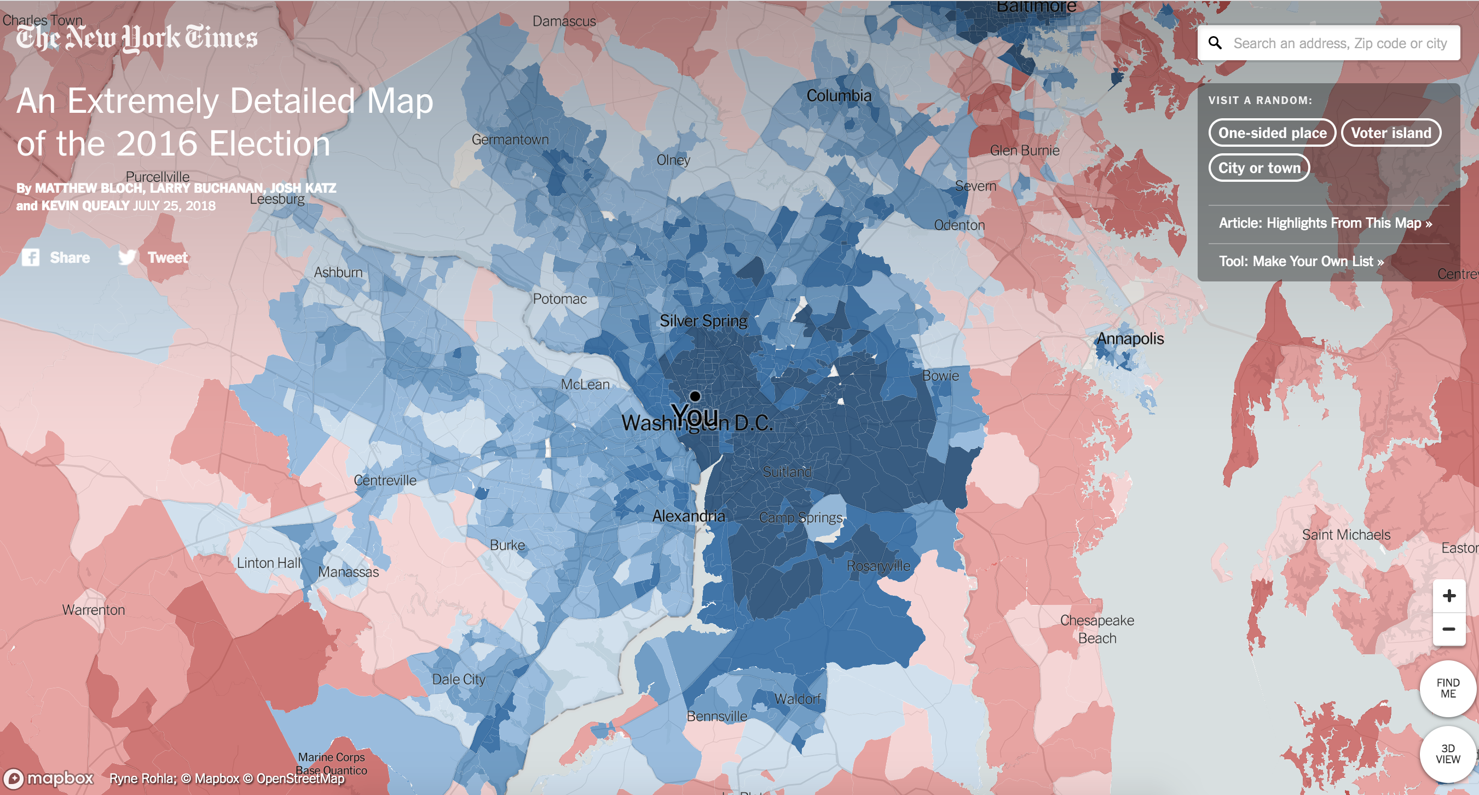
What Makes a Good Viz?
Have a goal – be useful to your reader

Slide 8
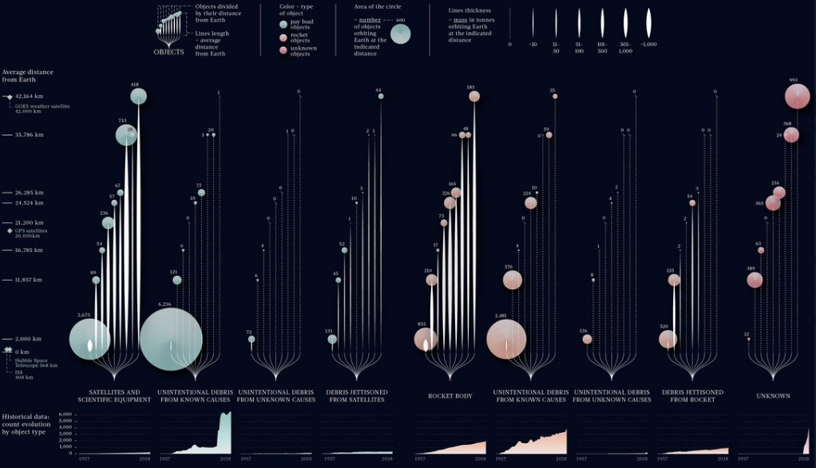
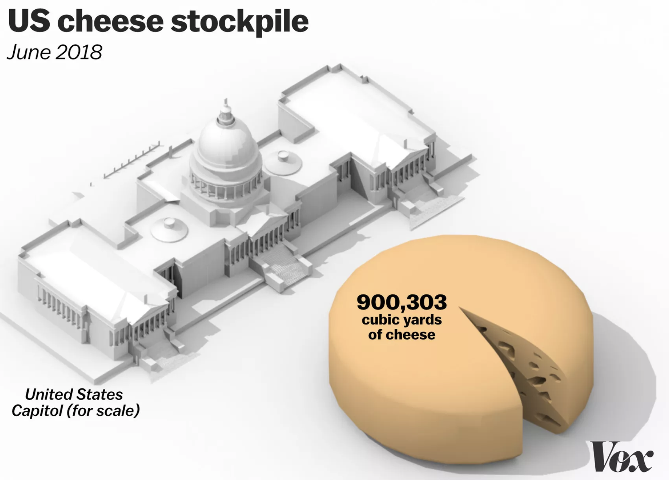
What Makes a Good Viz?
Be beautiful
Federica Fragapane

Slide 9
Unfortunately ….
It’s easier to make bad charts
In fact, there’s a whole Tumblr blog full of them http://viz.wtf/

Slide 10
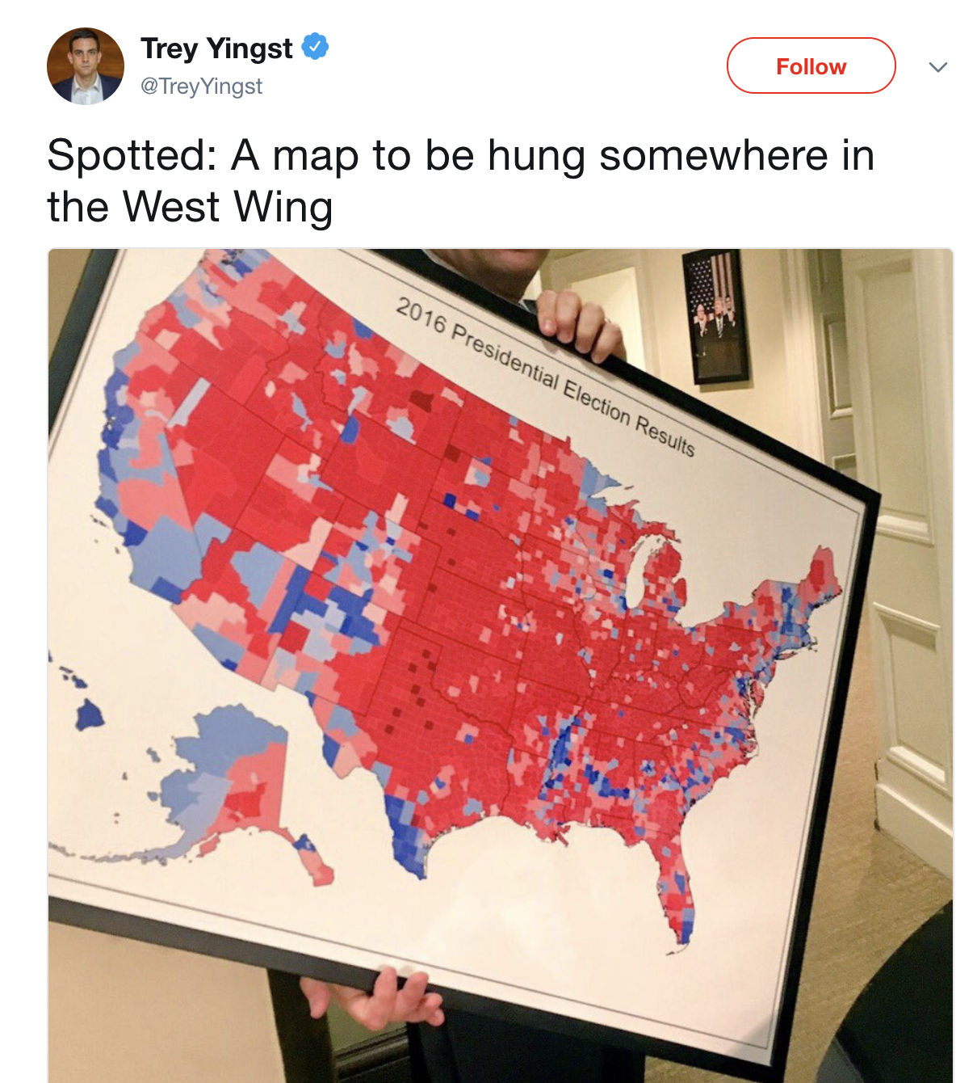
Unfortunately ….
And one we’ve all seen

Slide 11

Unfortunately ….
Some people love this map

Slide 12

Unfortunately ….
But it’s a distortion

Slide 13
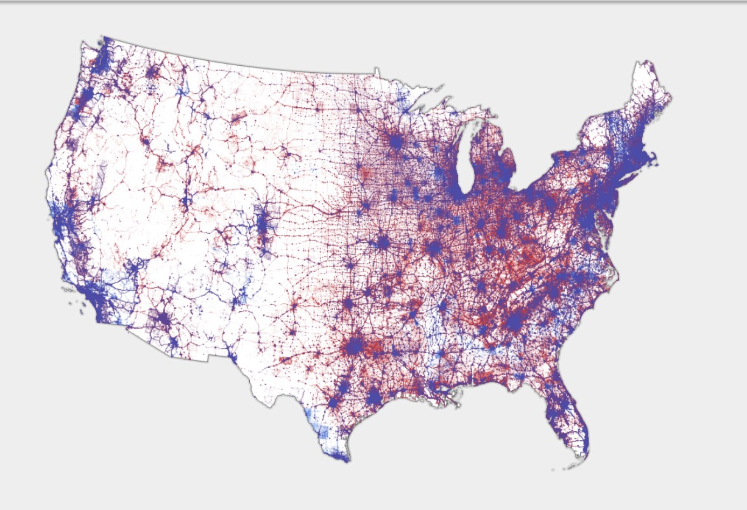
Distributed votes by population
https://www.wired.com/story/is-us-leaning-red-or-blue-election-maps/amp

Slide 14
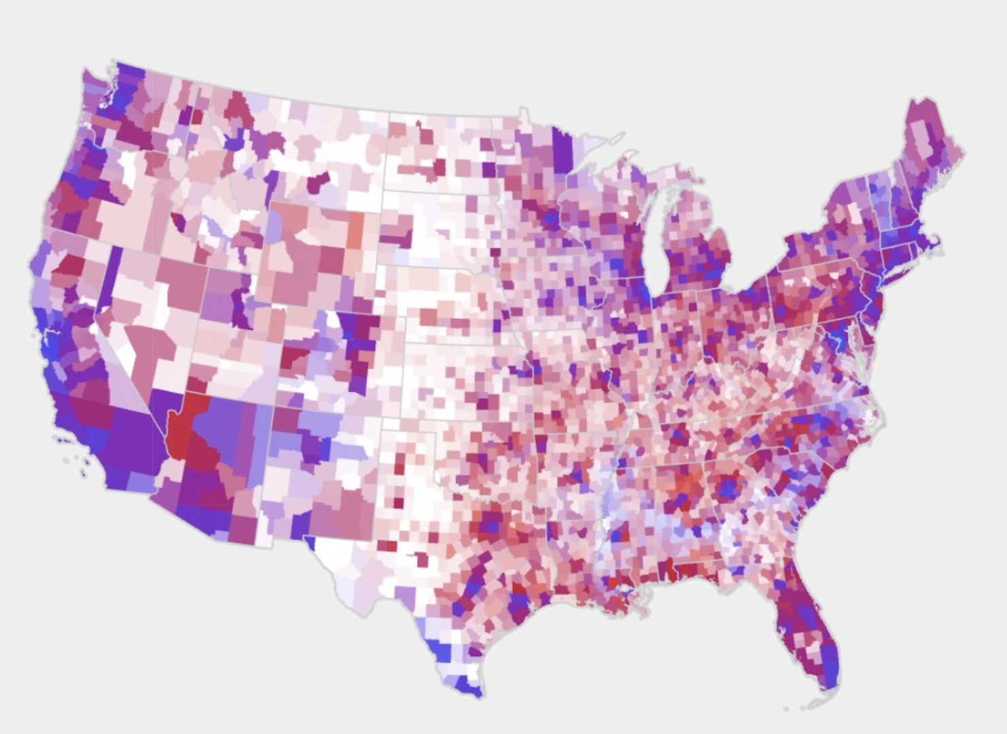
Difference in votes, with pop.
https://www.wired.com/story/is-us-leaning-red-or-blue-election-maps/amp

Slide 15
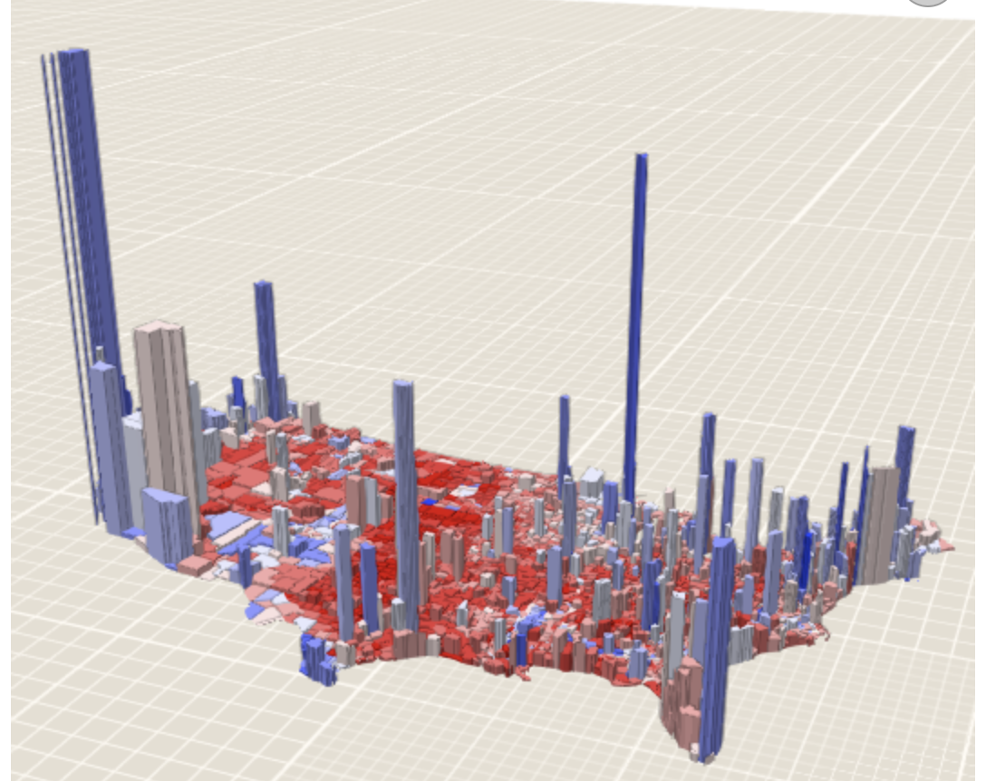
3D population vs. winner
https://www.wired.com/story/is-us-leaning-red-or-blue-election-maps/amp

Slide 17
So what’s a chartmaker to do?
Data story: Have a clear idea of what aspect you’re trying to convey
Function: Think about why/how your visualization would be useful to your readers, and ensure it does that
Design: Simplicity. Only add what is needed.

Slide 18
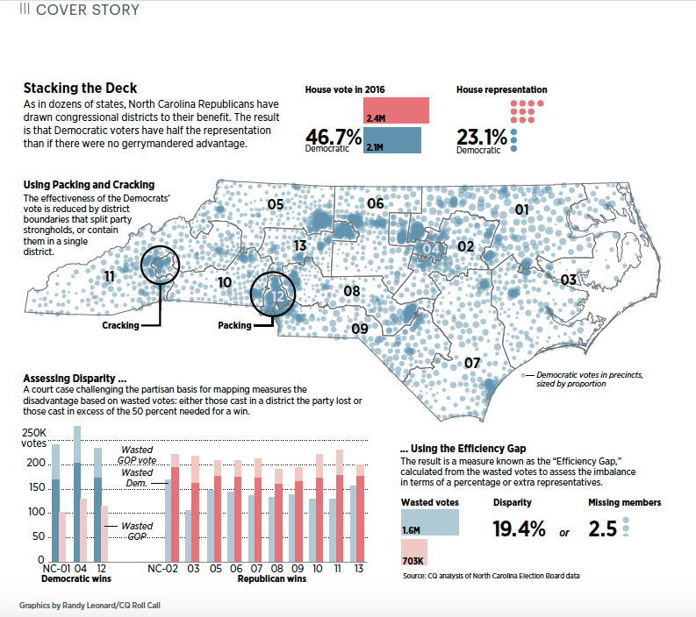
The process

Slide 19
The process

Slide 20
The process

Slide 21
The process
Find data

Slide 22
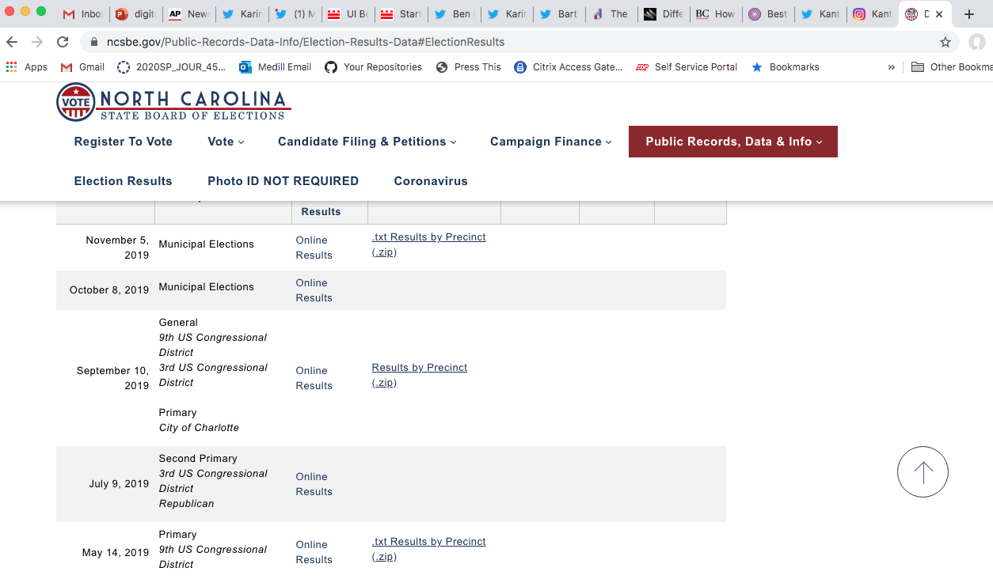
The process

Slide 23
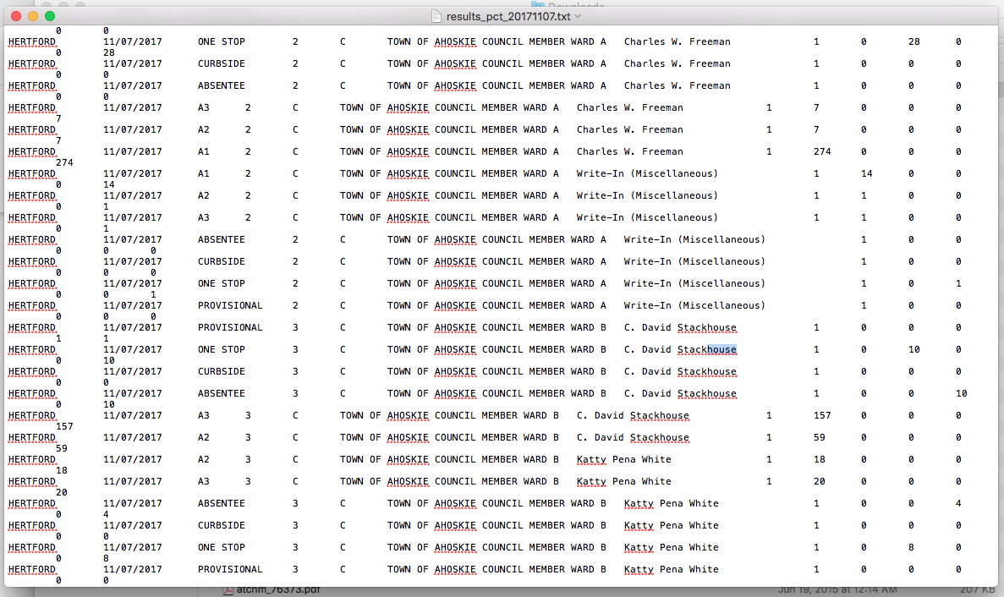
The process

Slide 24
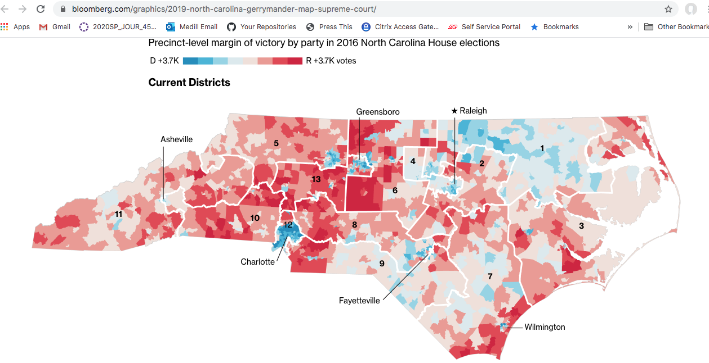
The process

Slide 25
The process

Slide 26
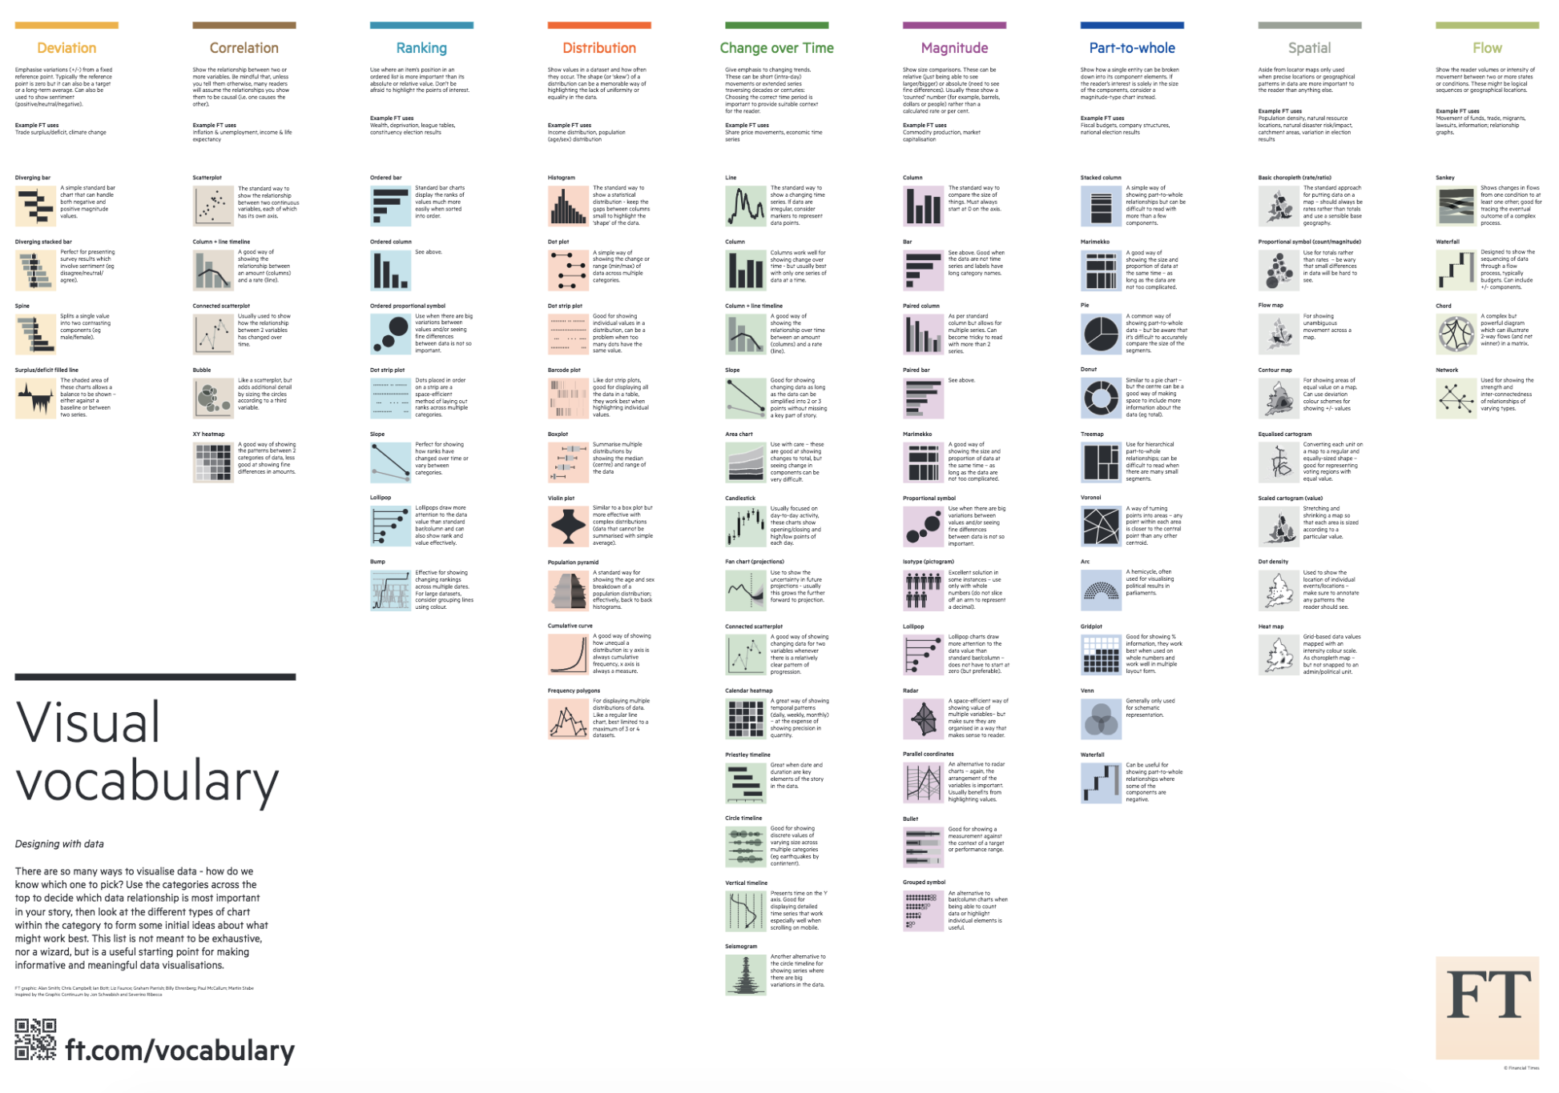
When to Use Different Charts

Slide 27
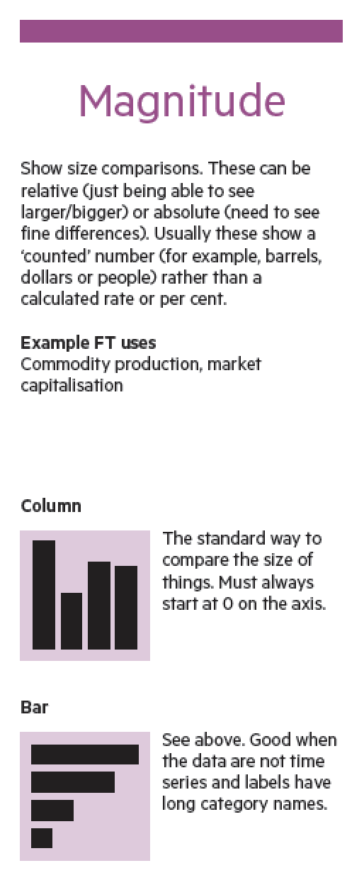
When to Use Different Charts

Slide 28
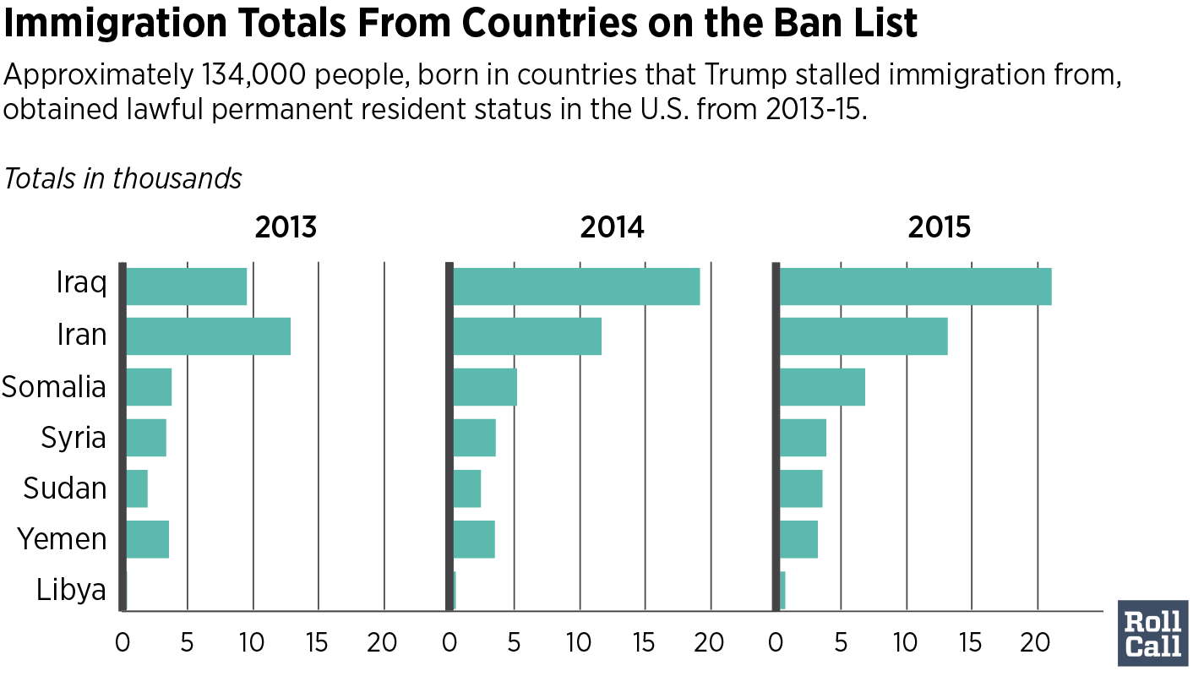
When to Use Different Charts

Slide 29
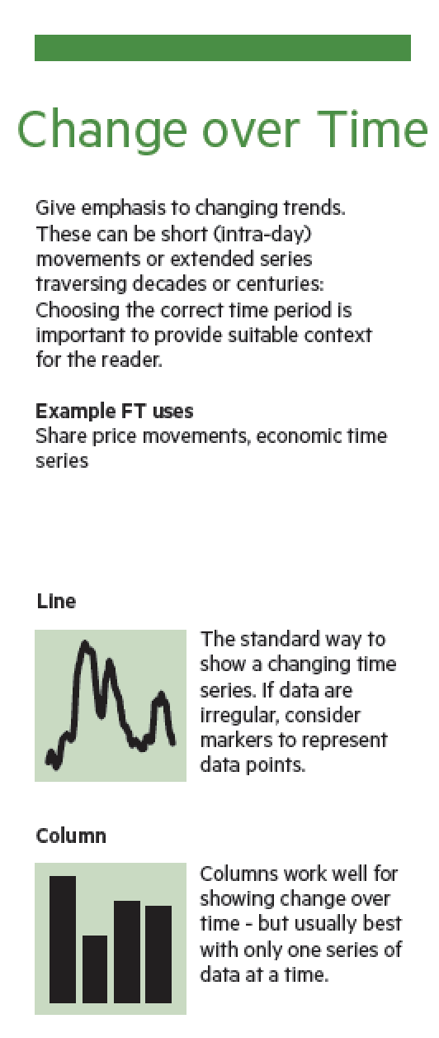
When to Use Different Charts

Slide 30
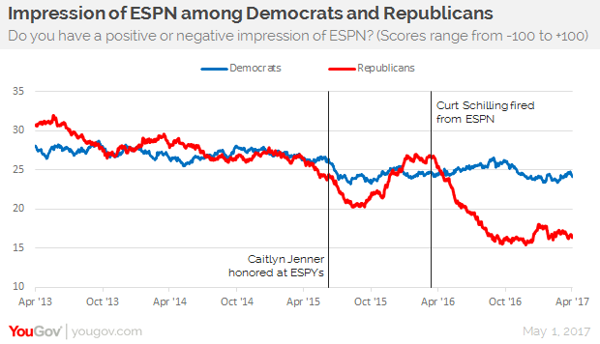
When to Use Different Charts

Slide 31
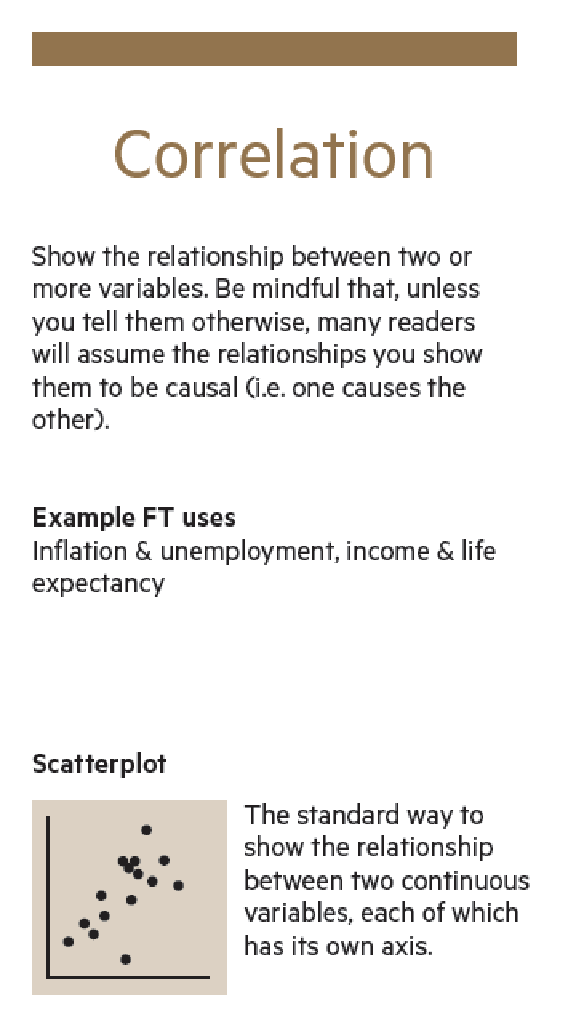
When to Use Different Charts

Slide 32
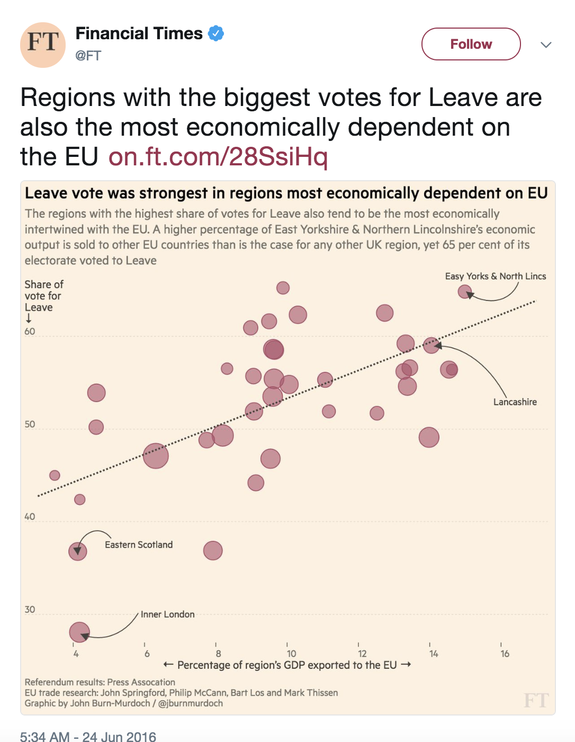
When to Use Different Charts

Slide 33
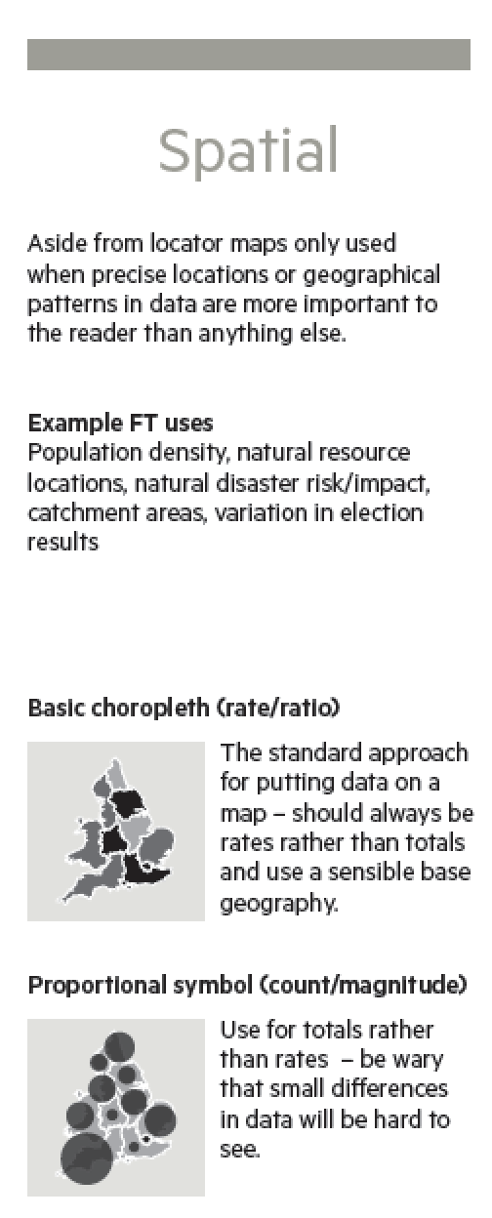
When to Use Different Charts

Slide 34
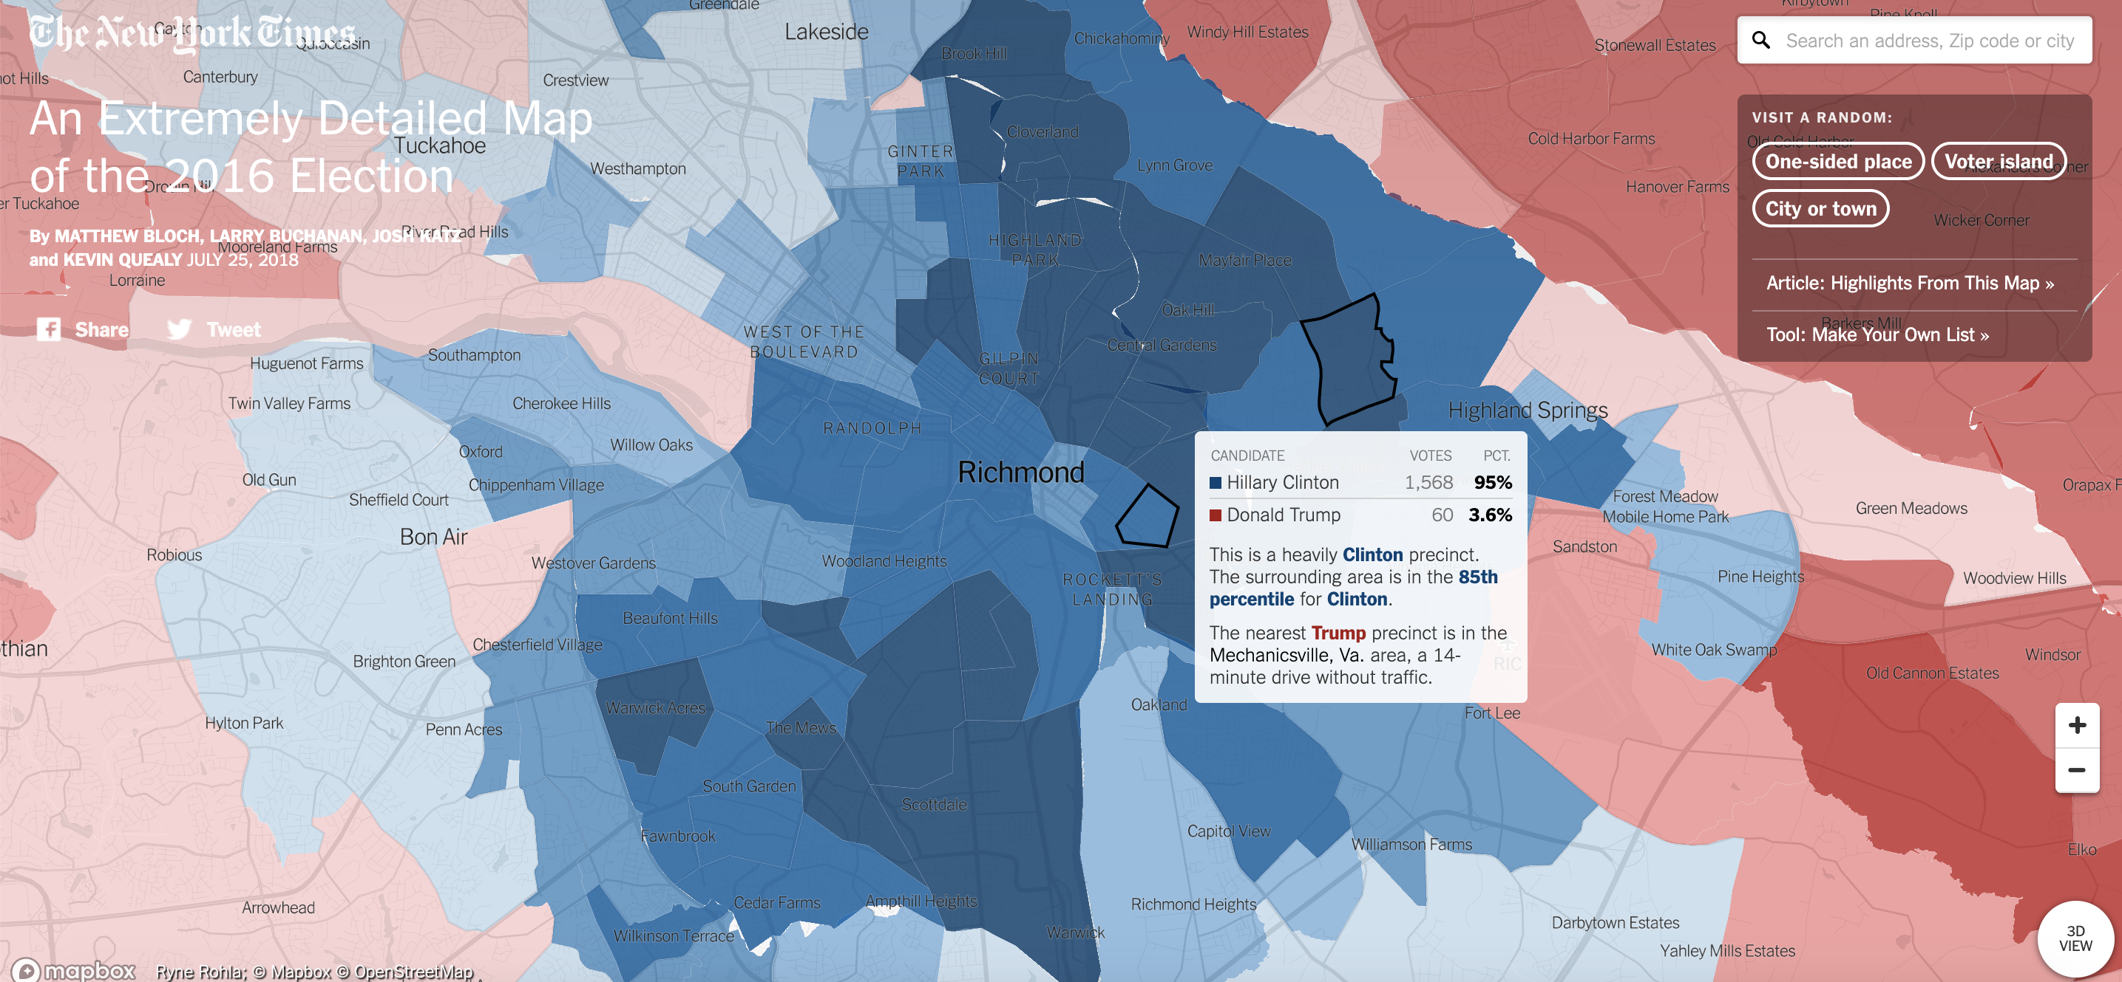
When to Use Different Charts

Slide 35
Resources
Norms and when to break
FT: When to use different charts
Simple tips
Data Visualisation – Andy Kirk
Alberto Cairo

